Slide 1
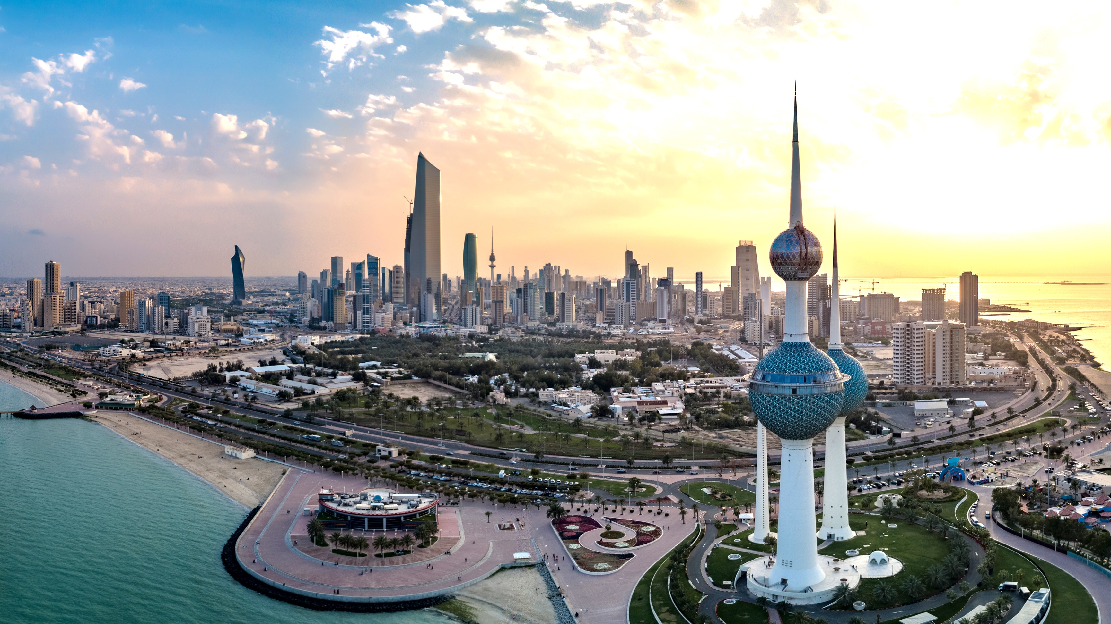


The Professional
Qualifications Programme
Raising Professional Standards
in the Capital Markets Sector in Kuwait

Slide 2
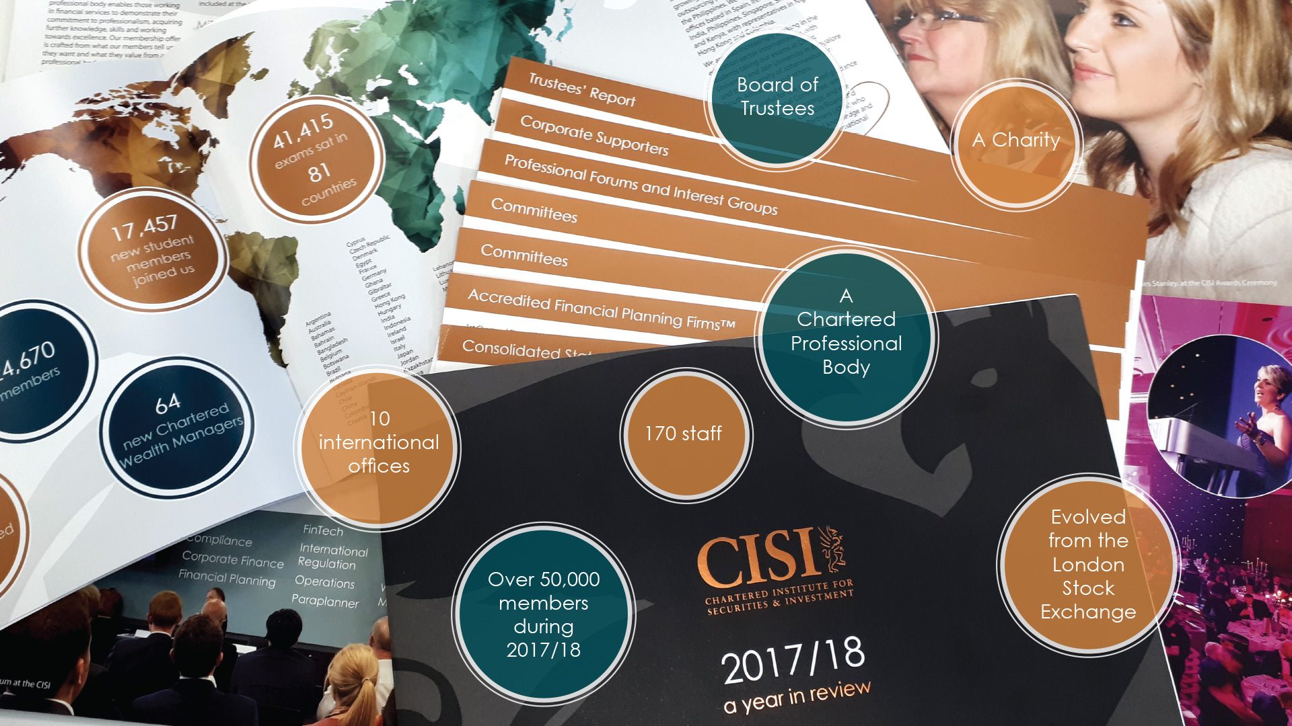

Key information about the CISI
A Charity
A Chartered Professional Body
Evolved from London Stock Exchange 25 years ago
Board of Trustees
170 staff
45,000 individual members…
…of which 20,000 are student members
40,000 exams each year
10,000 publications
International offices

Slide 3
CISI Mission Statement
“
To set standards of professional excellence and integrity for the securities, investment, wealth and financial planning professionals, providing qualifications and promoting the highest level of competence to our members, individuals and firms
“

Slide 4
What is Professionalism?
Knowledge
Skills
Professionalism
Behaviour

Slide 5
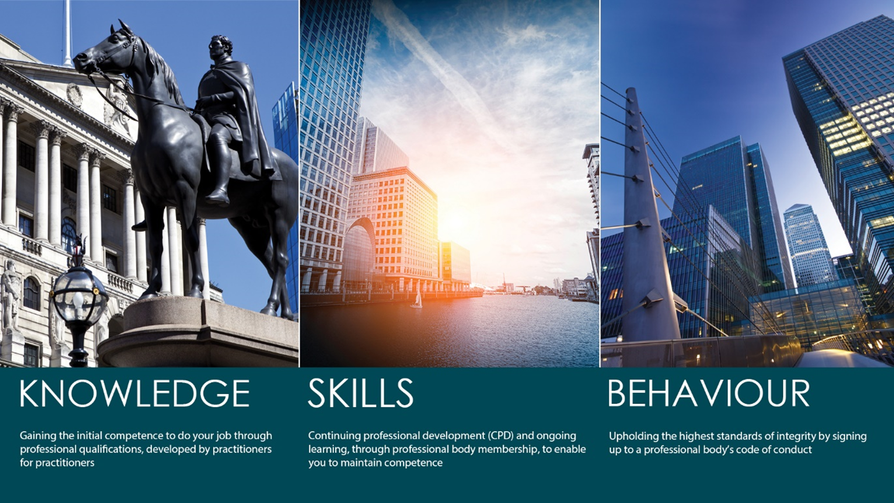
Introducing the CISI
The CISI is a charity which emerged from the London Stock Exchange when it was demutualised over 20 years ago and currently employs 170 professionals, including specialist examination managers and technical operations staff and has over 300 industry volunteers to its credit. The Institute operates globally, with its headquarters in London and regional offices in Mumbai, Dubai, Singapore, Manila, Spain, Columbia, Dublin and Colombo, plus representation in Kenya and Nigeria
In the last twelve months, over 41,000 CISI qualifications have been taken in over 85
countries and over 48,000 people are individual members in 116 countries, with about 20,000 being fully qualified.
The CISI is fully accredited by the UK Regulator, the Financial Conduct Authority (FCA), and is licensed to issue annual Statements of Professional Standing (SPSs) to suitably qualified individuals. The CISI is also regulated by the UK Education Regulator, Ofqual and is fully compliant with all its regulations and requirements.
The CISI’s qualifications are internationally recognised in more than 36 countries and over 92% of the world’s leading banks employ staff who have qualified with the CISI.

Slide 6



Main activities
ATTAIN Competence
Testing knowledge, awarding qualifications
MAINTAIN Competence
Membership for continuing professional development
Promote TRUST
Promote high standards of integrity & ethics
To set standards of professional excellence and integrity for the securities and investment industry, providing qualifications and promoting the highest level of competence

Slide 7
CISI professional qualifications
Created by practitioners for practitioners
Demonstrate ability to practically apply your knowledge
Prepared by practitioners in their field
Study pathways for career progression
Internationally portable
Opportunities for professional body membership

Slide 8

Knowledge
Wealth Management
Capital Markets
Corporate Finance
Risk
Investment Management
Compliance
Investment Operations
Islamic Finance
Financial Planning

Slide 9
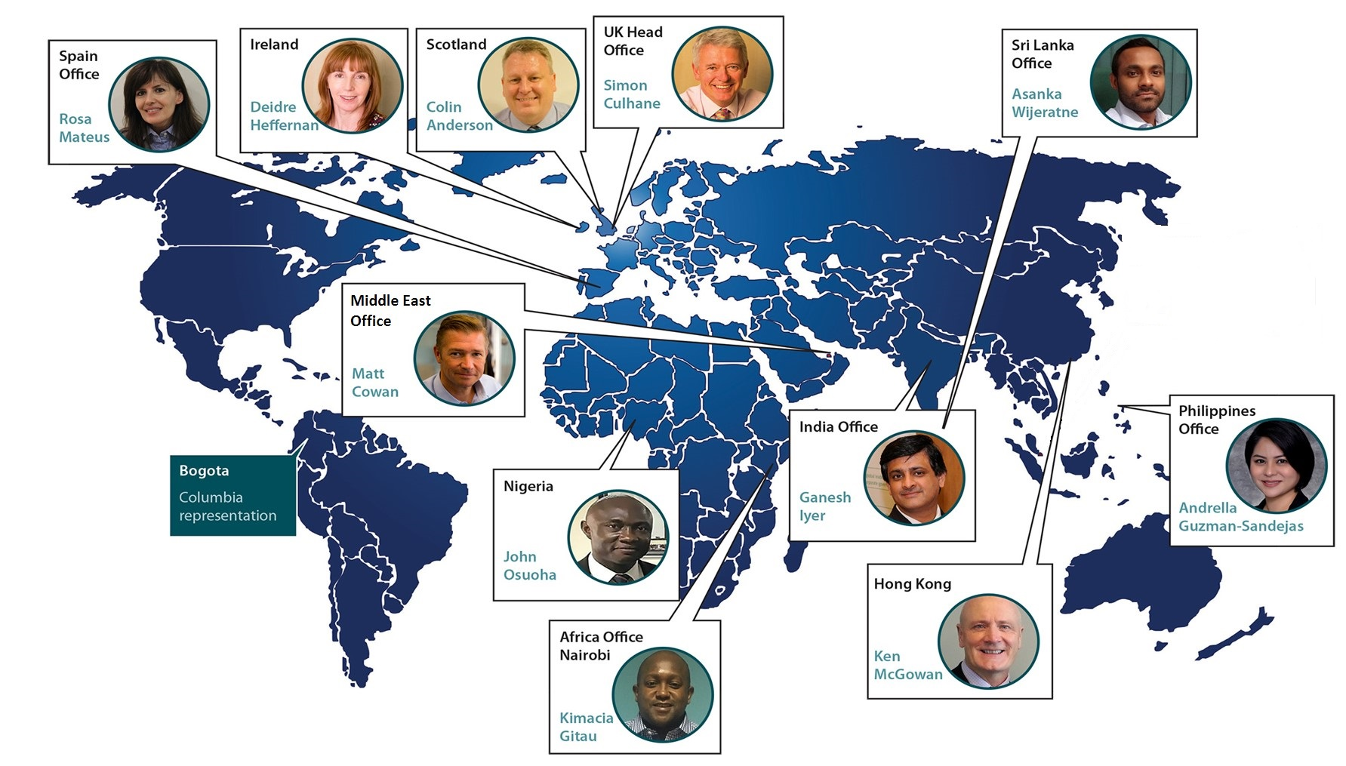
International Representation

Slide 10
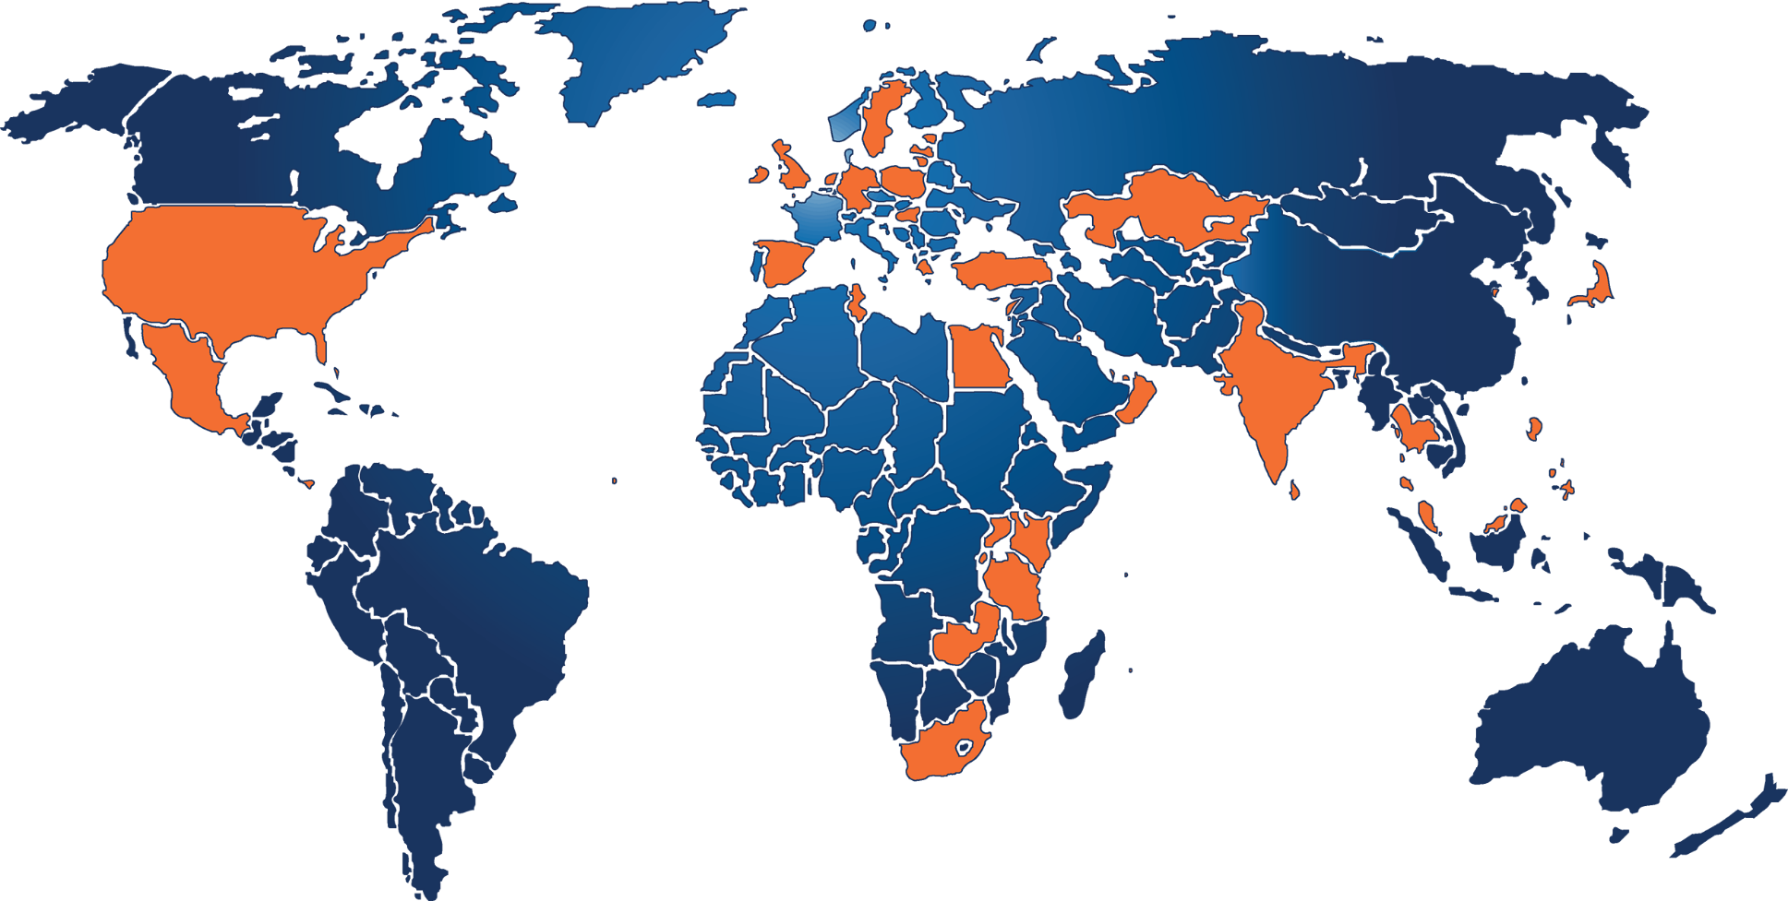
Global Regulatory Connections
Formal links in 47 jurisdictions
We have links with all of the top 5 and nearly 50% of top 20 financial centres
Bahamas
Bahrain
China*
Cyprus
Egypt
Estonia
Gibraltar
Greece
Guernsey
Hong Kong
India
Ireland
Isle of Man
Japan
Jersey
Kazakhstan
Kenya
Kuwait
Laos
Latvia
Lebanon
Lithuania
Malaysia
Malta
Mauritius
Mexico
Netherlands
Oman
Palestine
Panama
Qatar
Rwanda
Seychelles
Singapore
South Africa
Spain
Sri Lanka
Sweden
Tanzania
Tunisia
Turkey
Thailand
UAE
Uganda
UK
USA
Zambia

Slide 11








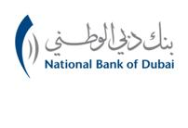




















Who works with us and take our exams?

Slide 12
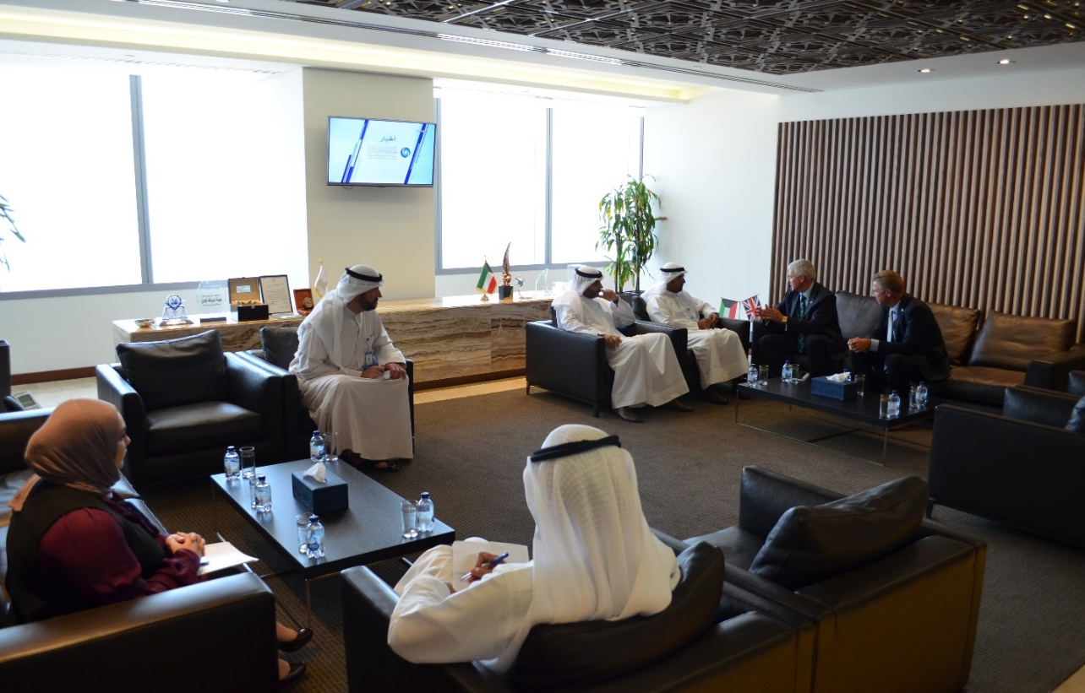
Certification and Licensing of Capital Market Practitioners
As part of CMA’s endeavor to develop the securities sector in the State of Kuwait, practitioners in specified positions, in the capital markets sector will now be certified through the application of international qualification tests for registered employment positions of licensed persons.
The introduction of a certification programme will ensure, that securities practitioners have the requisite knowledge and skill as Kuwait creates an attractive investment environment that acquires the confidence of investors.

Slide 13
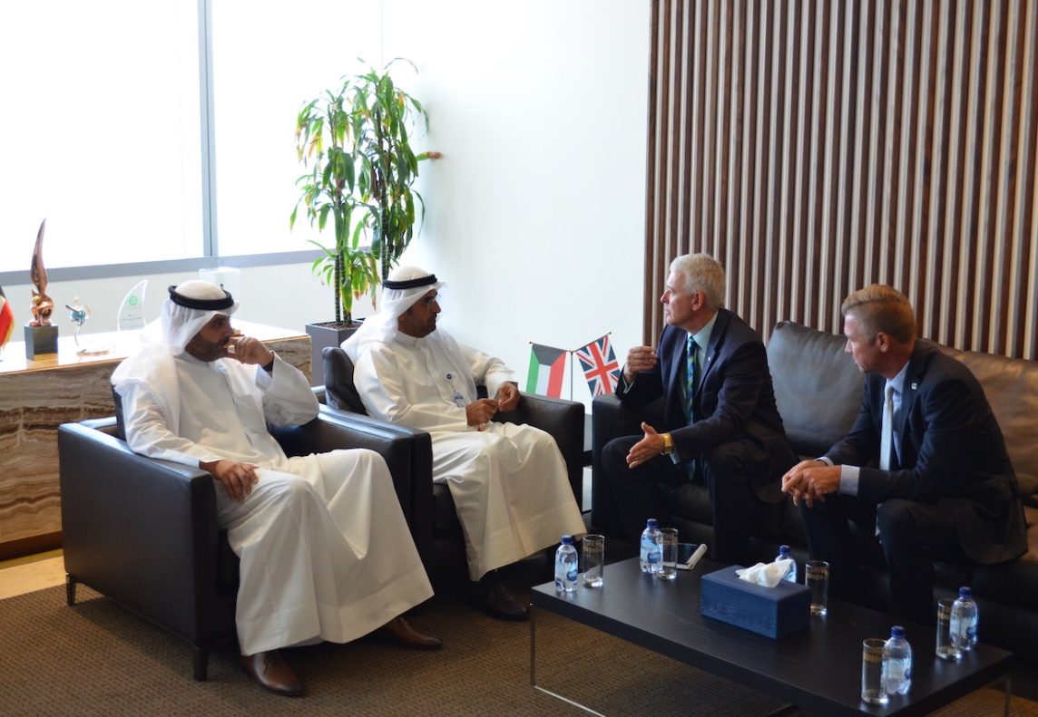
The licensing of practitioners aims to
Raise the efficiency of market participants
Emphasise the CMA’s role in keeping up with best international practice
Provide protection for practitioners in securities activities
Enable the CMA to achieve its strategic plan to develop the securities sector in the State of Kuwait
Diversify its investment instruments and promote the CMA to the rank of its counterparts in the global markets

Slide 14
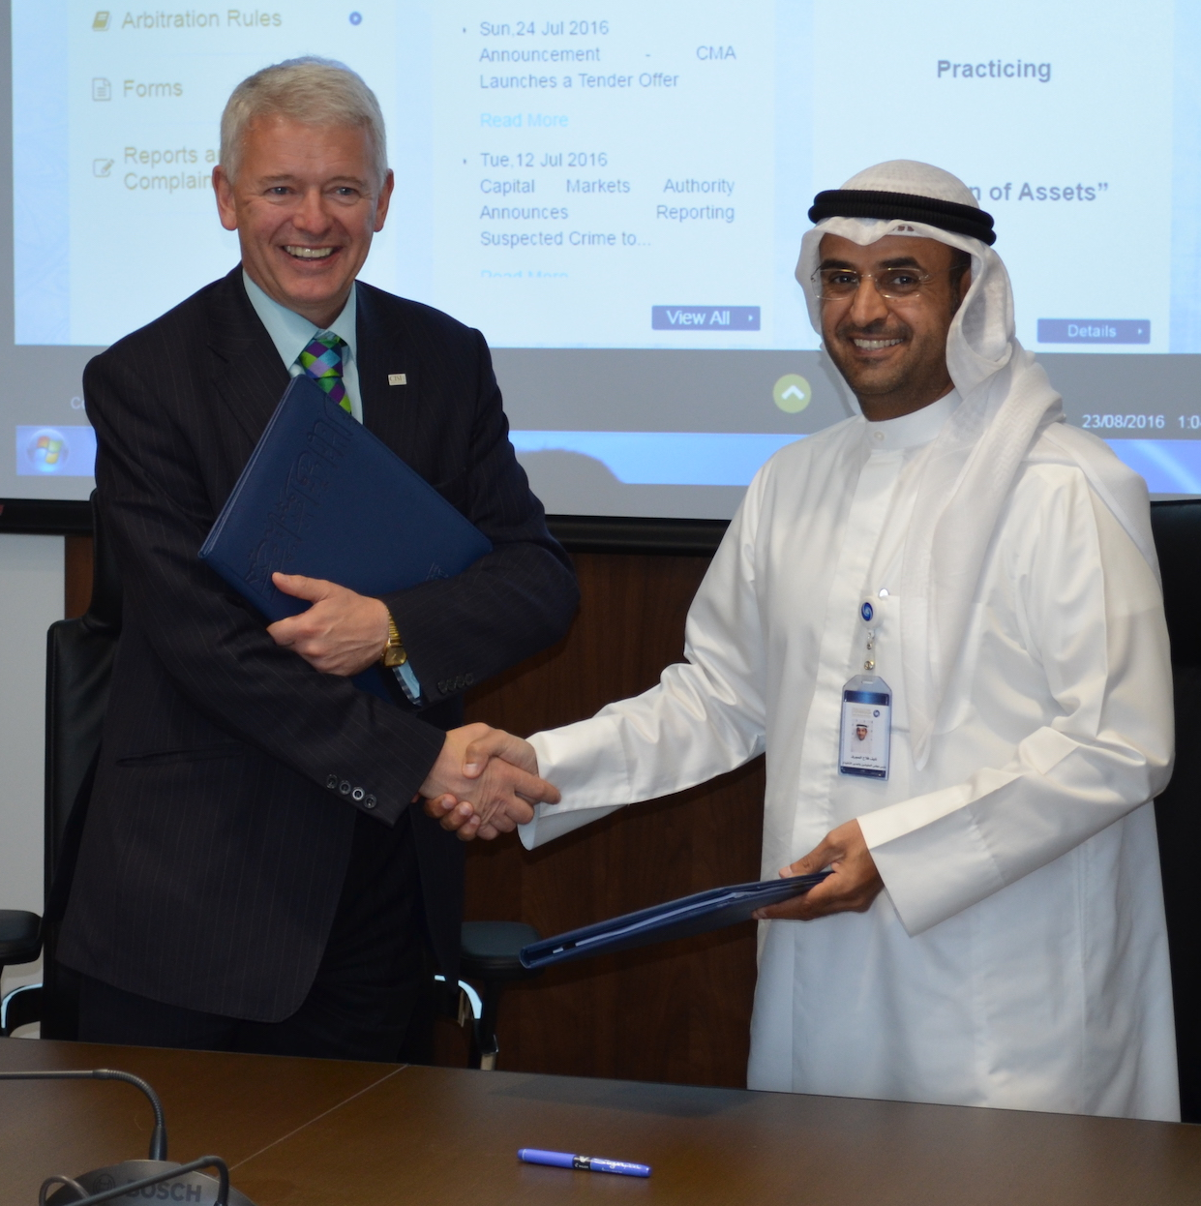
The programme comprises a combination of the CISI’s existing international qualifications and a bespoke Kuwaiti qualification in both Arabic and English.

Slide 15
CMA and CISI Professional Qualifications Programme
Responsible Officers
REGISTERED EMPLOYMENT POSITION
Compliance Officer
Risk Management Officer
Internal Audit Officer
Sharia Audit Officer
TECHNICAL QUALIFICATION
(MANDATORY)
International Introduction to Securities & Investment
Fundamentals of Islamic Banking & Finance
REGULATORY QUALIFICATION
(MANDATORY)
Kuwait CMA Rules & Regulations
SPECIALISED QUALIFICATION
(OPTIONAL)
Global Financial Compliance
Risk in Financial Services
Islamic Finance Qualification
AWARD
CISI/KCMA Professional Qualifications Programme Award

Slide 16
Securities Activities Representatives
REGISTERED EMPLOYMENT POSITION
Securities Broker Registered in Securities Exchange
Securities Broker not Registered in Securities Exchange
Qualified Securities Broker Registered with an Exchange
Investment Advisor
Investment Portfolio Manager
Collective Investment Scheme Manager
Investment Controller
Valuation of Assets
Subscription Agent
Market Maker
Senior Investment Manager
TECHNICAL QUALIFICATION
(MANDATORY)
Fundamentals of Financial Services/ Fundamentals of Islamic Banking & Finance
International Introduction to Securities & Investment/ Islamic Finance Qualification*
Risk in Financial Services
REGULATORY QUALIFICATION
(MANDATORY)
Kuwait CMA Rules & Regulations
SPECIALISED QUALIFICATION
(OPTIONAL)
Securities
International Certificate in Wealth and Investment Management
Corporate Finance Technical Foundation
Securities
Investment Management Certificate
AWARD
CISI/KCMA Professional Qualifications Programme Award

Slide 17
All exams booked online at www.cisi.org (Corporate accounts and block bookings available)
Exams are conducted through Computer Based Testing (CBT)
Results instantly available
Exam e-certificates available from mycisi section of website for download and printing

Slide 18
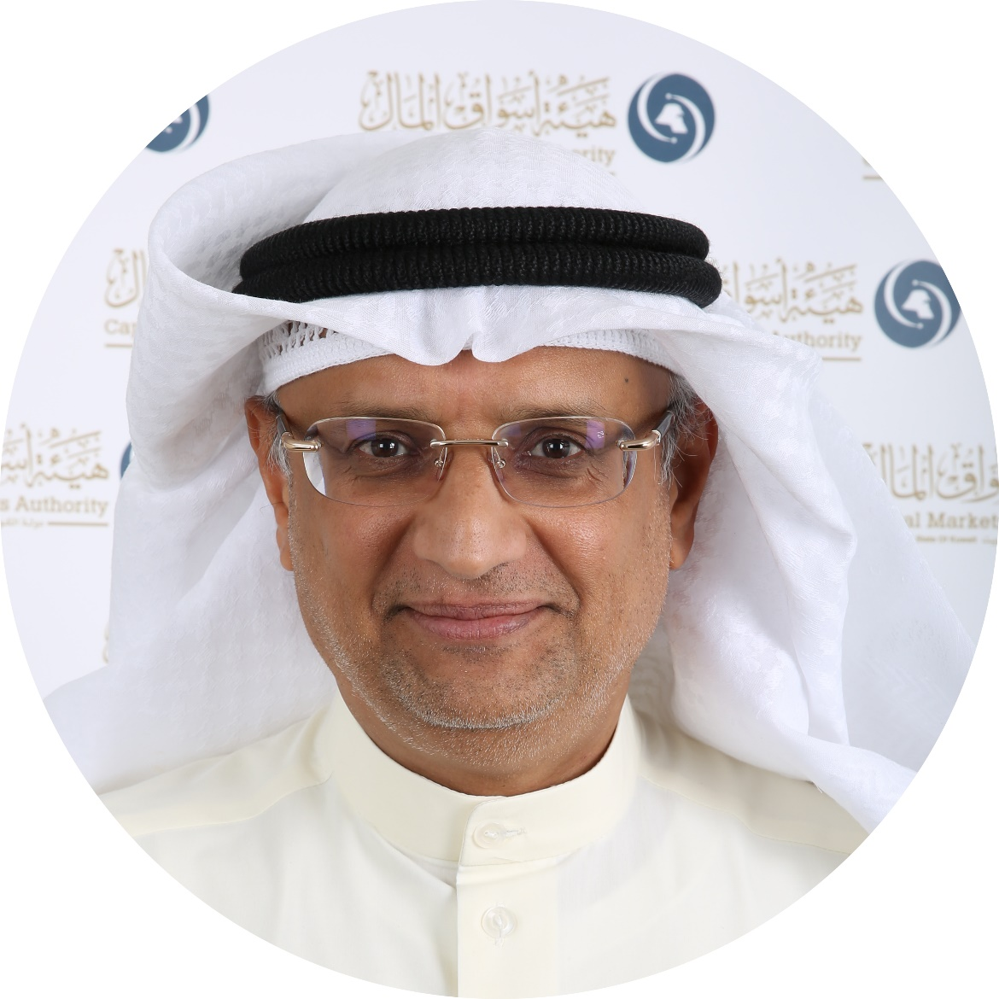
“
CMA Kuwait’s partnership with CISI in implementing its Professional Qualifications Program represents one of the important strategic approaches of the CMA in light of its overall vision for the development of the financial institutions and capital markets industry, in accordance with best international practices.
“
Prof. Ahmad A. Al-Melhem, Managing Director &
Chairman of CMA Board of Commissioners

Slide 19
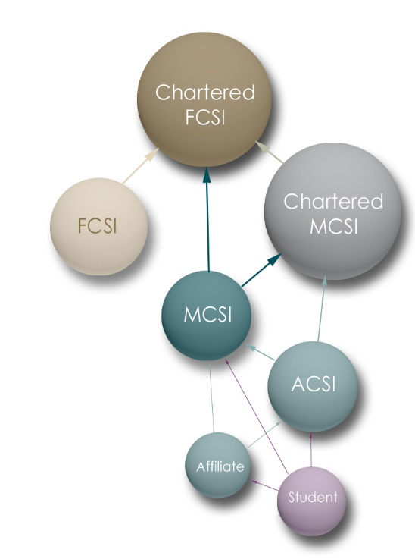
Maintaining competence and acquiring new skills
Qualifications are just the entry ticket to the party
Next trend is continual learning (CPD)
10 – 35 hours of structured learning has been mandatory for members since April 2017
“We acknowledge, as many have reminded us, that competence is not just about examinations. It is about skills, knowledge, expertise, ethical behaviour and the application and maintenance of all of these” - UK Regulator

